Slide 1

Karwaan
Your Travelling Partner
sr

Slide 2
Index
Introduction
Trip Planning
Key Features
Customer Focus
Redefining Travel Experiences
Personalized Itineraries
Curated Destinations and Activities
Exceeding Expectations

Slide 3
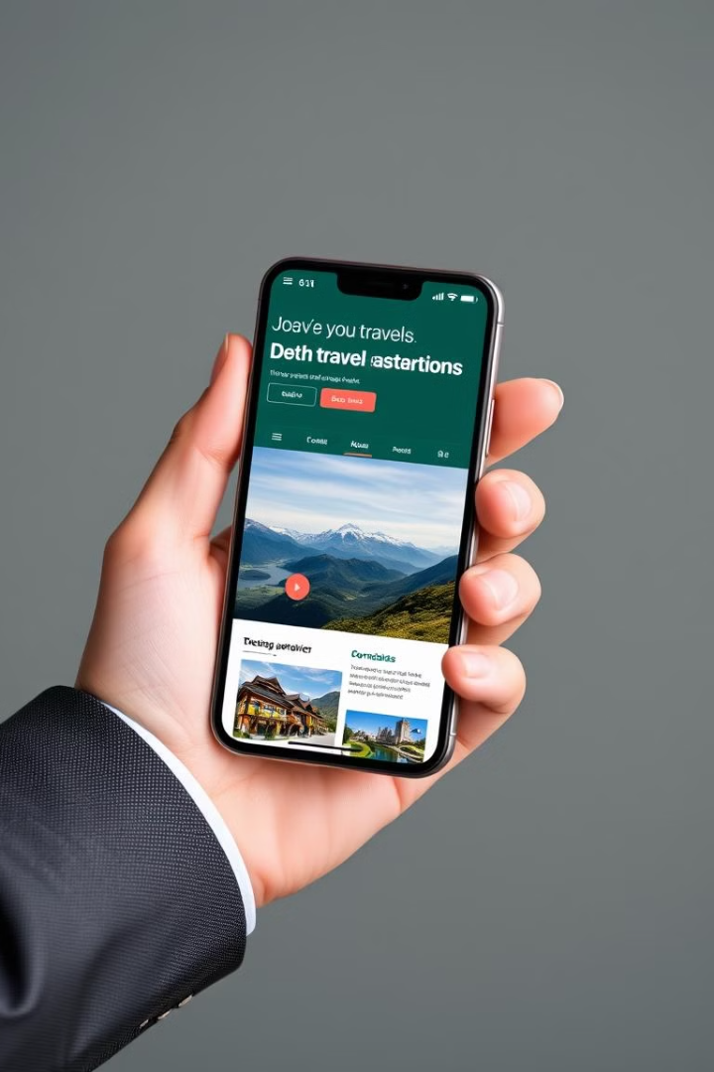
Introducing Karwaan: Redefining Travel Experiences
Personalized
Intuitive
Karwaan is a vibrant travel website offering a unique focus on India's rich cultural and historical destinations.
Our user-friendly platform empowers you to plan effortlessly, with Trip Customization and booking .
Engaging
Empowering
Discover hidden gems, local experiences, and authentic cultural encounters through our curated content.
Take control of your journey, personalize your itinerary, and embrace the freedom to explore at your own pace.

Slide 4
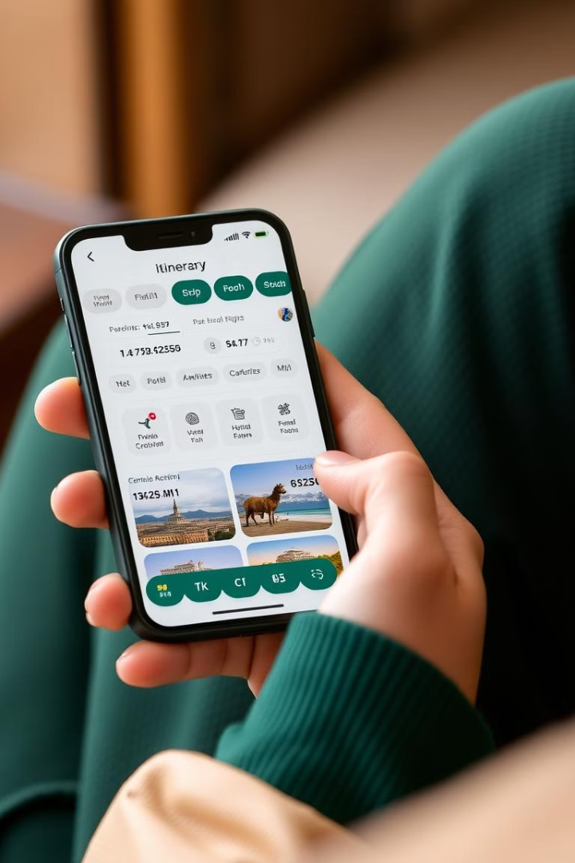




Seamless Trip Planning: Personalized Itineraries
Destination Selection
Choose your dream destination from our extensive list of Indian culture.
Interest Profiling
Tell us your travel preferences, budget, and desired activities to refine your itinerary.
Uploads
You can uploads your photos , videos on Karwaan .
Booking and Management
Book your travelling plan according to your budget.

Slide 5
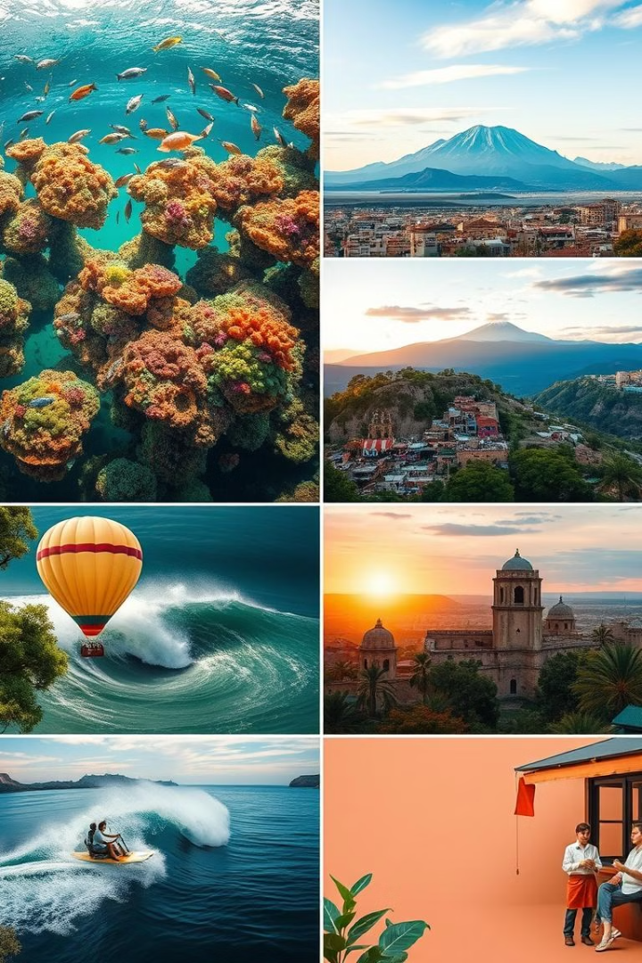



Karwaan Highlights: Curated Destinations and Activities
Destinations
Famous place of the destination
(the place you must visit) .
Curated Activities
Foodie Delights
Discover unique experiences, local tours, cultural immersions, adventure activities, and more.
It offers famous food and famous place where you can try dishes.

Slide 6




Customer-Centric Approach: Exceeding Expectations
TRIP CUSTOMISATION
1
“Tailor your perfect journey with Karwaan – travel your way, your style!"
BLOGS & ARTICLES
2
Inspire with Blogs articles and pictures.
BEST TIME TO VISIT
3
Offers best when and where to go.
REVIEWS & RATINGS
4
Reviews depend on customer .

Slide 7
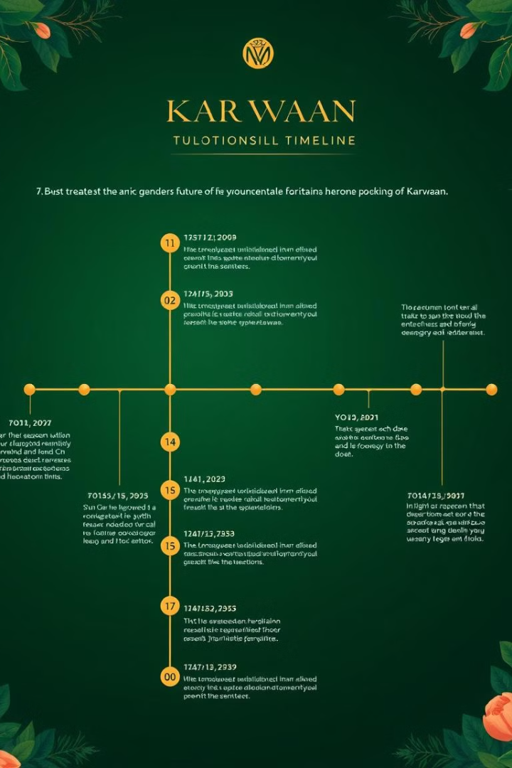
Road Map
1
Phase 1: HTML
2
Phase 2: CSS
3
Phase 3: Responsiveness
4
Phase 4: Back-end In Development

Slide 8
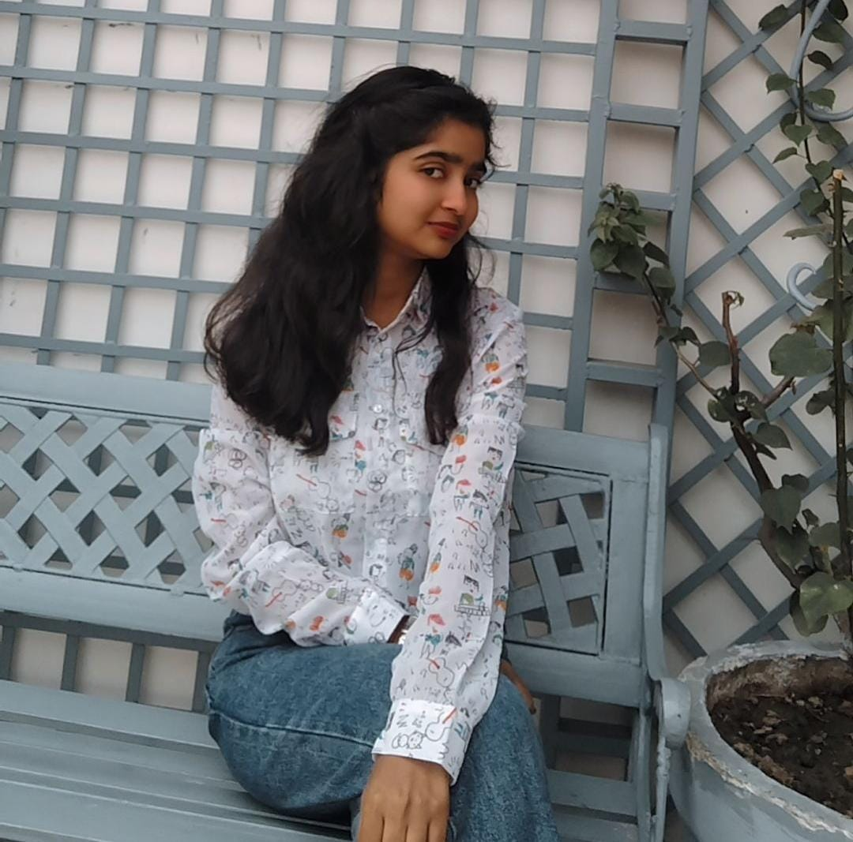

Team Members
SAKSHI RAI (GL)
HARSH PANDEY
MANAGEMENT / GROUP LEADER
DEVELOPER

Slide 9

Thank You

